Slide 1
Programming with C and Python for Newbies
Day 5:Loops - for loops & while loops

Slide 2
Loops
Loops helps us in programming to repeat a block of code repeatedly and they make our code more efficient.

Slide 3
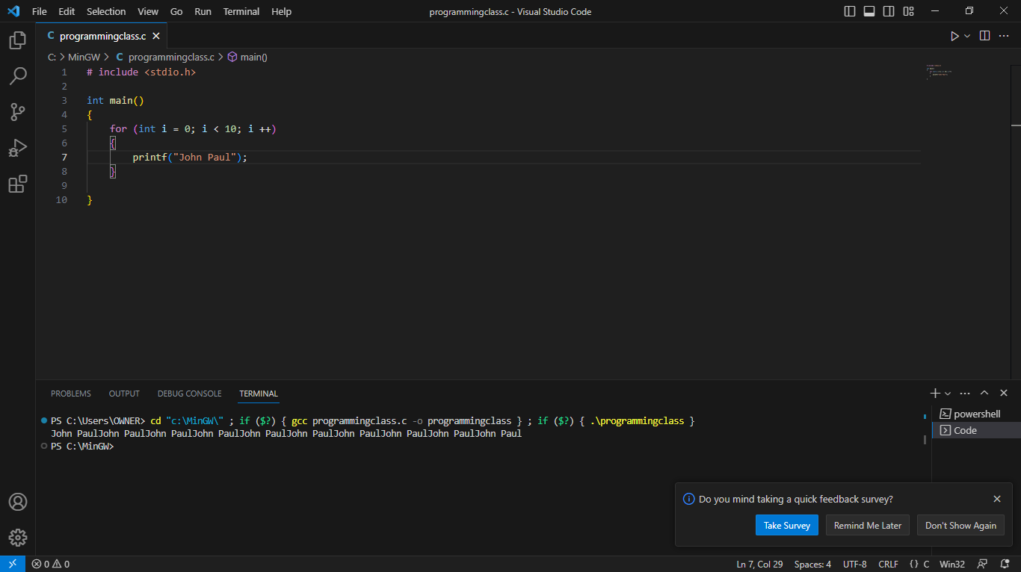
For loop
This is used when you know exactly how many times you want to repeat a block of code.
It takes in three arguments:
1.You initialize a variable
2.Condition when you want the loop to stop
3.Update after each iteration

Slide 4
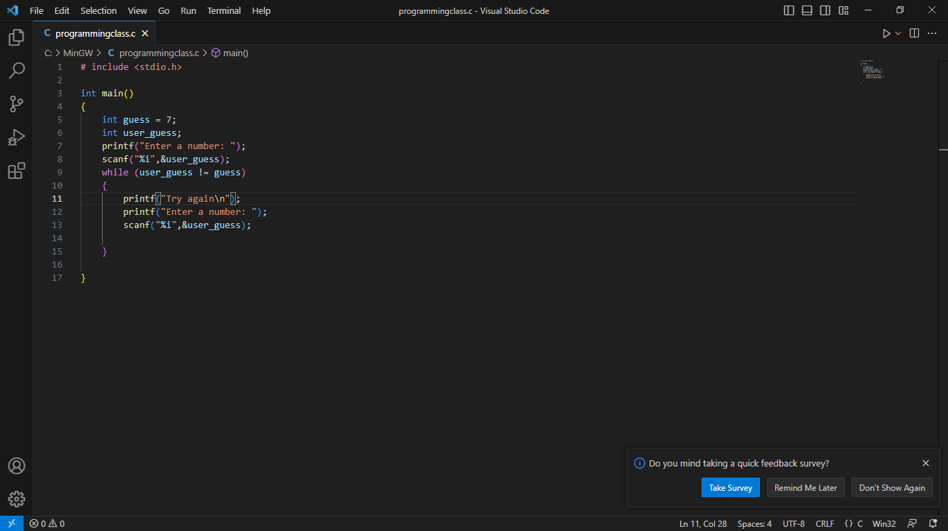
While loop
This loop is often used when you don’t know in advance how many times you’ll loop.
It takes only one argument which is the condition when you want to stop

Slide 5
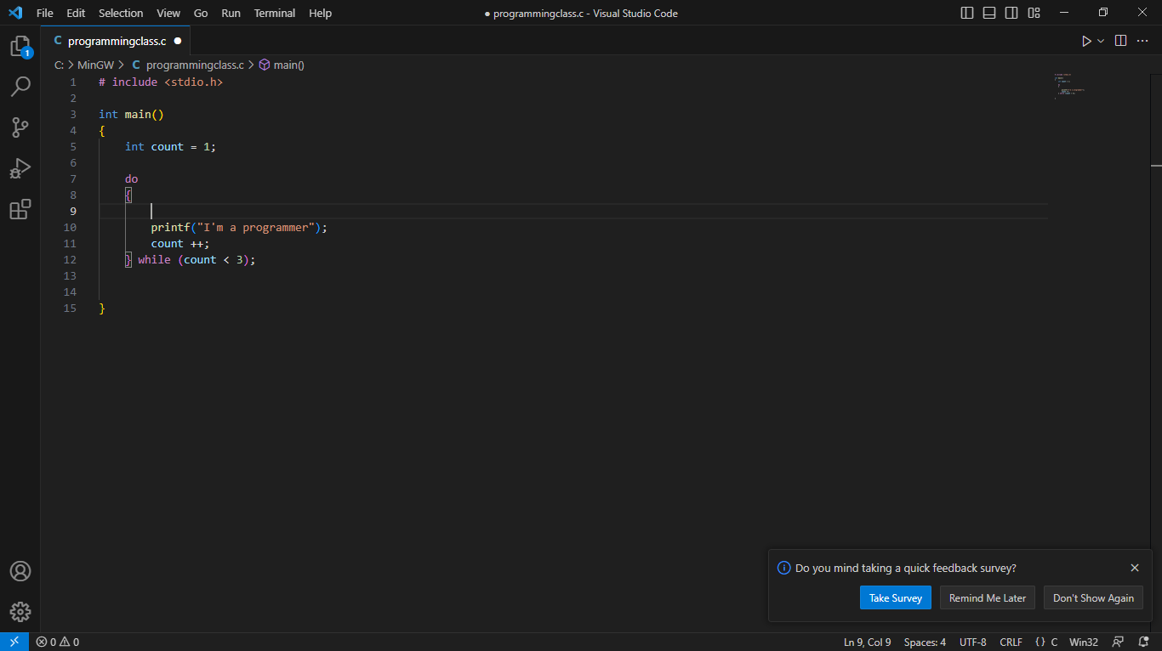
Do-while loop
This loop is similar to the ‘while loop’ but it allows us to run the block of code once before checking the condition.

